Slide 1
Unit 2.8
Algorithm

Slide 2
Things To Be Discussed In This Unit
Program Design
Concept and Definition
Design of algorithm
Characteristic of algorithm
Big O notation

Slide 3
Learning Objectives
Understand the type of problem that will be covered in this class
Recognize some problems for which sophisticated algorithms might not be necessary.
Question if your solution technique is an efficient one? Any room for optimization?

Slide 4
Program Design
Involves taking the specification and designing solutions, the designer needs to adopt a design strategy.
Solution Strategy should work correctly in all conditions
A large program should be divided into small modules and sub modules.
Other important criteria by which a program can be judged are execution time and storage requirement

Slide 5
Algorithms
The term ’algorithm’ refers to the sequence of instructions that must be followed to solve a problem.
Logical representation of the instructions which should be executed to perform a meaningful task.
Algorithms are generally created independent of underlying languages, i.e. an algorithm can be implemented in more than one programming language.

Slide 6
An algorithm has certain characteristics
Each instruction should be unique and concise.
Each instruction should be relative in nature and should not be repeated infinitely
Repetition of same task(s) should be avoided.
The result should be available to the user after algorithm terminates.

Slide 7
NOTE:
After an algorithm has been designed, its efficiency must be analyzed. i.e CPU time and memory
Memory space and running time should be taken care of.
The importance of efficiency of an algorithm is in the correctness, i.e does it always produce the correct result, and program complexity which considers both the difficulty of implementing an algorithm along with its efficiency

Slide 8
Properties of an Algorithm
Input: A number of quantities are provided to an algorithm initially before the algorithm begins. These quantities are inputs which are processed by the algorithm.
Definiteness: Each step must be clear and unambiguous.
Effectiveness: Each step must be carried out in finite time.
Finiteness: Algorithms must terminate after finite time or step
Output: An algorithm must have output.
Correctness: Correct set of output values must be produced from the each set of inputs.

Slide 9
Write an algorithm to find the greatest number among three numbers
Step 1: Read three numbers and store them in X, Y and Z
Step 2: Compare X and Y. if X is greater than Y then go to step 5 else go to step 3
Step 3: Compare Y and Z. if Y is greater than Z then print “Y is greatest” and go to step 7 otherwise go to step 4
Step 4: Print “Z is greatest” and go to step 7
Step 5: Compare X and Z. if X is greater than Z then print “X is greatest” and go to step 7 otherwise go to step 6
Step 6: Print “Z is greatest” and go to step 7
Step 7: Stop

Slide 10
Different Approaches To Designing An Algorithm
A complex system may be divided into smaller units called modules.
The advantage of modularity is that it focuses on specific module.
Modularity enhances design clarity, which in turn eases implementation, debugging, testing, documenting and maintenance of the project.
To design a hierarchy of a system there are two possible approaches
  Top-down approach
  Bottom-up approach

Slide 11
Top-Down Approach
How it is done?
  Identify the major components of the system,
  decompose them into their lower-level components and
  Iterate until the desired level of module complexity is achieved.
It basically starts with the big picture. It breaks down from there into smaller segments.
Top-down design method takes the form of stepwise refinement.

Slide 12
Bottom-Up Approach
A bottom-up approach is the piecing together of systems to give rise to more complex systems
Bottom-up method works with layers of abstraction.
Elements are then linked together to form larger subsystems, which then in turn are linked, sometimes in many levels, until a complete top-level system is formed.
This strategy often resembles a "seed" model, by which the beginnings are small but eventually grow in complexity and completeness.

Slide 13
Top-Down versus Bottom-Up Approach
The top-down approach, however, is often useful way to better document a design.
The design activity should not be constrained to proceed according to a fixed pattern but should be a blend of top-down and bottom-up approaches

Slide 14
Complexity
When we talk of complexity in context of computers, we call it computational complexity.
Computational complexity is a characterization of the time or space requirements for solving a problem by a particular algorithm.
Lesser the complexity better an algorithm.

Slide 15
Complexity
Given a particular problem, let ’n’ denote its size. The time required of a specific algorithm for solving this problem is expressed by a function:
f : R->R
Such that, f(n) is the largest amount of time needed by the algorithm to solve the problem of size n.
Function ‘f’ is usually called the time complexity function.
Thus we conclude that the analysis of the program requires two main considerations:
  Time Complexity (time required for completion)
  Space Complexity (memory required for completion)

Slide 16
Time Complexity
While measuring the time complexity of an algorithm, we concentrate on developing only the frequency count for all key statements (statements that are important and are the basic instructions of an algorithm)
This is because, it is often difficult to get reliable timing figure because of clock limitations and the multiprogramming or the sharing environment.

Slide 17
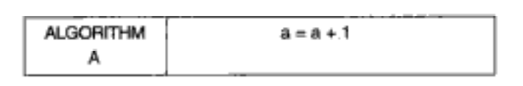
Algorithm A
In an algorithm A we may find that the statement a=a+1 is independent and is not contained within any loop.
Therefore, the number of times this shall be executed is 1.
We say that the frequency count of an algorithm A is 1.

Slide 18
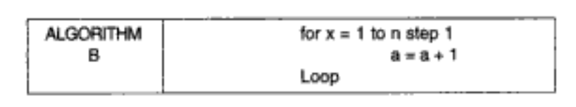
Algorithm B
In this algorithm, i.e. B, the key statement is the assignment operation a=a+1.
Because this statement is contained within a loop, the number of times it is executed is n, as the loop runs for n times.
The frequency count for this algorithm is n.

Slide 19
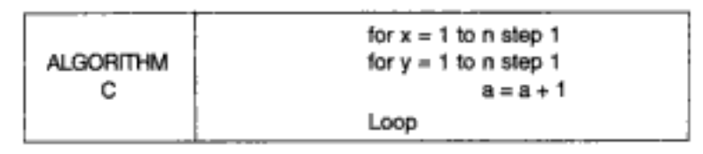
Algorithm C
The frequency count for the statement a=a+1 is n² as the inner loop runs n times, each time the outer loop runs, the inner loop also runs for n times.
If an algorithm perform f(n) basic operations when the size of its input is n, then its total running time will be cf(n), where c is a constant that depends upon the algorithm, on the way it is programmed, and on the way the computer is used, but c does not depend on the size of the input

Slide 20
Space Complexity
Space complexity is essentially the number of memory cells which an algorithm needs.
A good algorithm keeps this number as small as possible, too.
There is often a time-space-tradeoff involved in a problem, that is, it cannot be solved with few computing time and low memory consumption.
Space complexity is measured with respect to the input size for a given instance of a problem.

Slide 21
Naïve Algorithm Vs Efficient Algorithm

Slide 22
Ex 1: Greatest Common Divisor
DEFINITION:
  For integers, a and b, their greatest common divisor or gcd(a,b) is the largest integer d so that d divides both a and b
Compute GCD
  Input: Integers a,b ≥0
  Output: gcd(a,b)
Ex: Run on large numbers like
  gcd(3198848,1653264)

Slide 23
Function NaiveGCD(a,b)
Best=0 For d from 1 to a+b: if d/a and d/b: best=d return best
PROBLEMS:
  Takes too much time to complete
  Not an optimal solution

Slide 24
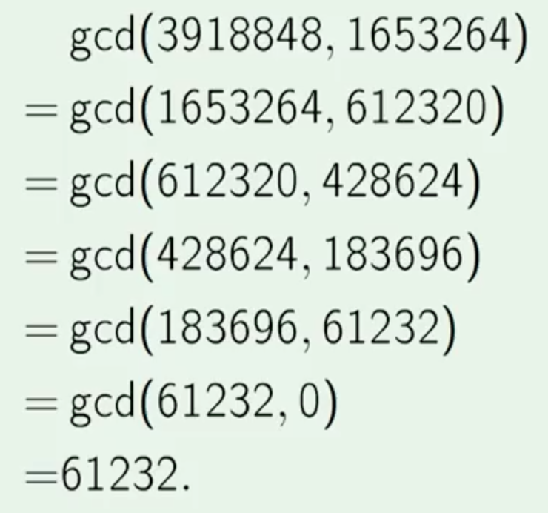
Function efficientGCD(a,b)
Lemma
  Let a’ be the remainder when a is divided by b, then
  gcd(a,b)=gcd(a’,b)=gcd(b,a’)
So what is gcd(357,234)?
Example
If b=0: return a a’ = the remainder when a is divided by b return efficientGCD(b,a’)

Slide 25
Summary of naïve vs efficient algorithms
Naïve algorithm is too slow
The correct algorithm is much better
Finding the correct algorithm requires knowing something interesting about the problem

Slide 26
Big O Notation

Slide 27
Intro
When solving a computer science problem there will usually be more than just one solution.
These solutions will often be in the form of different algorithms, and you will generally want to compare the algorithms to see which one is more efficient.
This is where Big O analysis helps – it gives us some basis for measuring the efficiency of an algorithm.
Big O measures the efficiency of an algorithm based on the time it takes for the algorithm to run as a function of the input size.

Slide 28
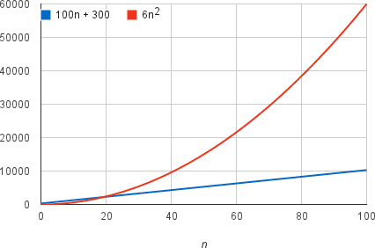
Asymptotic notation
For example, suppose that an algorithm, running on an input of size n, takes 6n² + 100n + 300 machine instructions.
The 6n²​​ term becomes larger than the remaining terms, 100 n + 300, once n becomes large enough, 20 in this case.
Here's a chart showing values of
​​ 6n²​​ and 100n + 300 for values of
n from 0 to 100:
We could say “f(n) grows at the order
Of n^{2”}. And write f(n)=O(n²)

Slide 29
Asymptotic notation
By dropping the less significant terms and the constant coefficients, we can focus on the important part of an algorithm's running time.
When we drop the constant coefficients and the less significant terms, we use asymptotic notation.
We'll see three forms of it: big-Θ notation, big-O notation, and big-Ω notation.

Slide 30
Big-O Notation
A function f(x)=O(g(x)) (read as f(x) is big oh of g(x) ) iff there exists two positive constants c and x₀ such that
for all x >= x₀, f(x) <= c*g(x)
Consider an example:
f(x)=5x³+3x²+4 find big O of f(x)
solution:
f(x)= 5x³+3x²+4
we can exclude the lower order polynomial so, f(x)=5x³
since, f(x)<c*g(x), where c=5 and x=3
Thus by definition of big oh O(f(x))=O(x³)

Slide 31
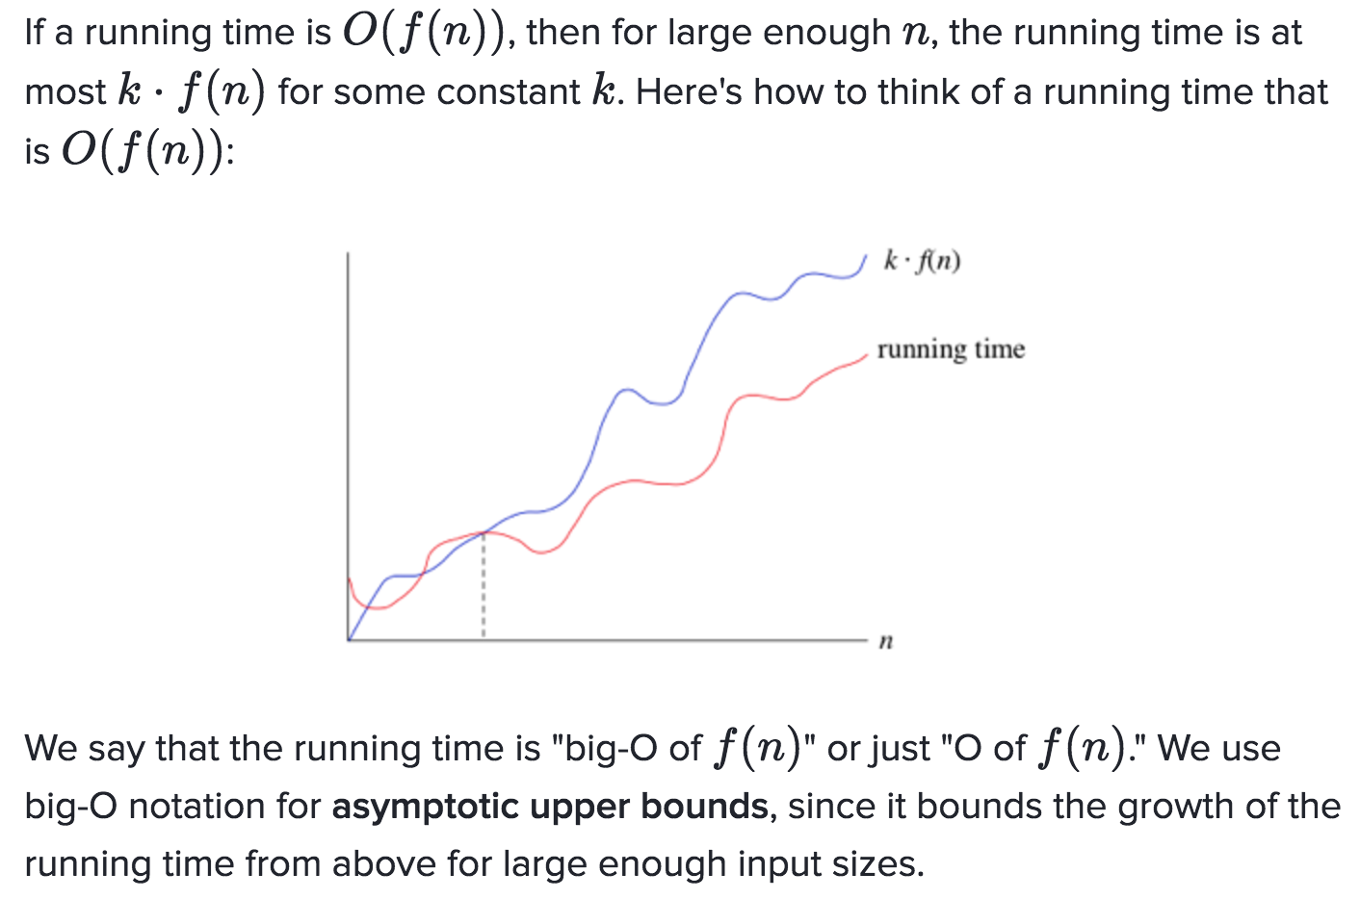
We use "big-O" notation for occasions such as "the running time grows at most this much, but it could grow more slowly.”

Slide 32
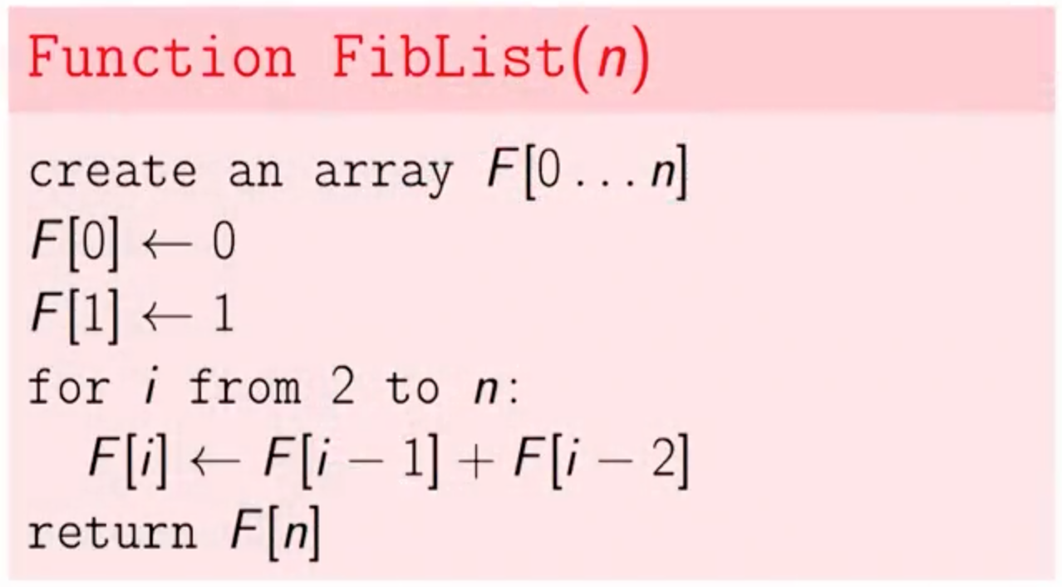
We have a Fibonacci algorithm.
We're just going to run through it operation by operation and ask how long it takes.

Slide 33
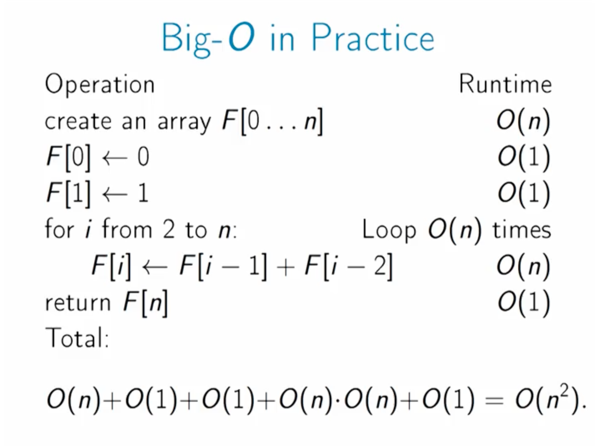

Slide 34
Big Omega (Ω) notation
Sometimes, we want to say that an algorithm takes at least a certain amount of time, without providing an upper bound.
We use big-Ω notation; that's the Greek letter "omega.”
A function f(x) =Ω (g(x)) (read as f(x) is big omega of g(x) ) iff there exists two positive constants c and x₀ such that for all x >= x₀, 0 <= c*g(x) <= f(x).
Therefore,
f(x)>=c*g(x)
The above relation says that g(x) is a lower bound of f(x).

Slide 35
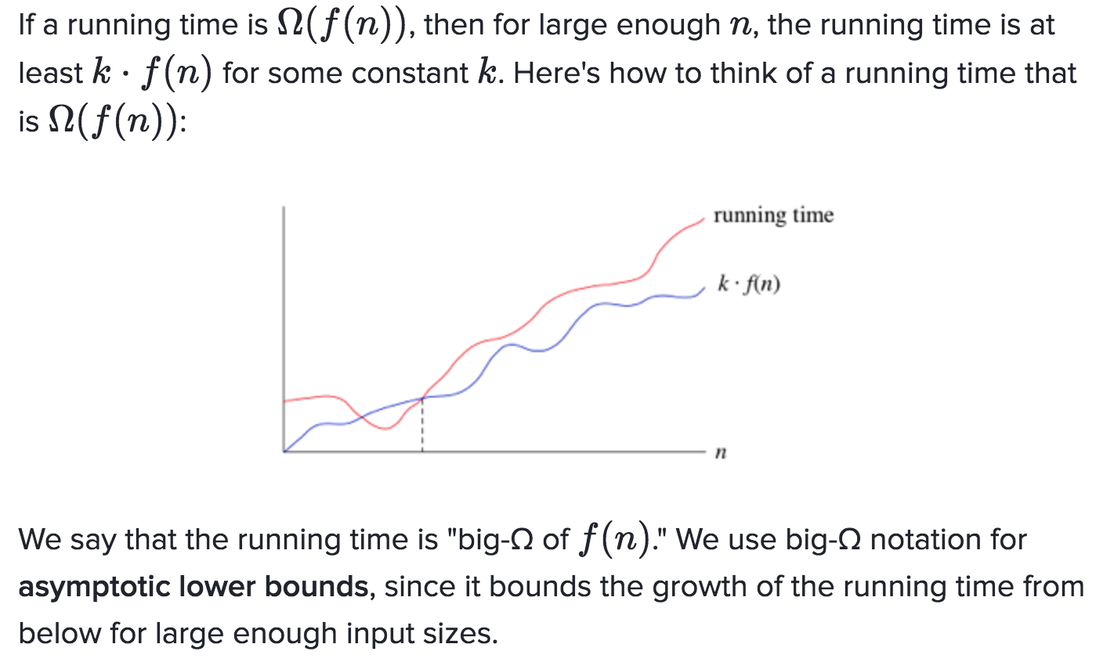
Big Omega (Ω) notation

Slide 36
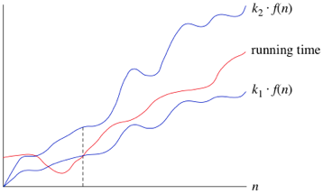
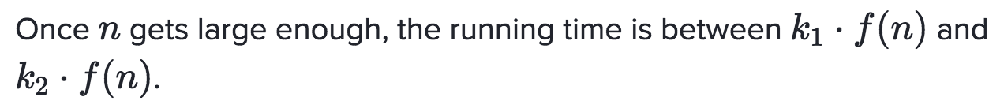
Big Theta (Θ) notation
When we need asymptotically tight bound then we use notation.
A function f(x) = (g(x)) (read as f(x) is big theta of g(x) ) iff there exists three positive constants c₁, c₂ and x₀ such that
for all x >= x₀, c₁*g(x) <= f(x) <= c₂*g(x)

